Slide 1
App Demo

Slide 2
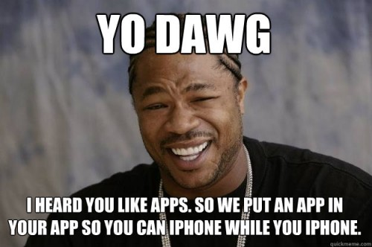

Slide 3
Code Explanations

Slide 4
Search Method
- (void)getNamesOfAllGooglePlacesWithTerm: (NSString *)term
Latitude:(NSString *)latitude
Longitude:(NSString *)longitude
CompletionHandler:(void (^)(NSArray *venueNames))completionBlock
{
NSString *googleStringURL = [NSString stringWithFormat:@"https://maps.googleapis.com/maps/api/place/nearbysearch/json?"];
NSString *latlng = [NSString stringWithFormat:@"%@,%@", latitude, longitude];
NSDictionary *urlParams = @{@"key":GOOGLE_API_KEY, @"location": latlng, @"keyword":@"Momo Sushi Shack", @"radius":@"20000"};
AFHTTPSessionManager *manager = [AFHTTPSessionManager manager];
[manager GET:googleStringURL parameters:urlParams success:^(NSURLSessionDataTask *task, id responseObject) {
NSArray *venuesArray = responseObject[@"results"];
NSMutableArray *googleVenues = [[NSMutableArray alloc] init];
for (NSDictionary *venue in venuesArray) {
GooglePlaces *googleVenue = [[GooglePlaces alloc] initWithName:venue[@"name"] Latitude:venue[@"geometry"][@"location"][@"lat"] Longitude:venue[@"geometry"][@"location"][@"lng"] Address:venue[@"vicinity"] Rating:venue[@"rating"] PriceLevel:venue[@"price_level"] OpenNow:venue[@"opening_hours"][@"open_now"]];
[googleVenues addObject:googleVenue];
}
completionBlock(googleVenues);
} failure:^(NSURLSessionDataTask *task, NSError *error) {
NSLog(@"Could not get google data");
}];
}

Slide 5
Search Method
- (void)getNamesOfAllGooglePlacesWithTerm: (NSString *)term
Latitude:(NSString *)latitude
Longitude:(NSString *)longitude
CompletionHandler:(void (^)(NSArray *venueNames))completionBlock
{
NSString *googleStringURL = [NSString stringWithFormat:@"https://maps.googleapis.com/maps/api/place/nearbysearch/json?"];
NSString *latlng = [NSString stringWithFormat:@"%@,%@", latitude, longitude];
NSDictionary *urlParams = @{@"key":GOOGLE_API_KEY, @"location": latlng, @"keyword":@"Momo Sushi Shack", @"radius":@"20000"};
AFHTTPSessionManager *manager = [AFHTTPSessionManager manager];
[manager GET:googleStringURL parameters:urlParams success:^(NSURLSessionDataTask *task, id responseObject) {
NSArray *venuesArray = responseObject[@"results"];
NSMutableArray *googleVenues = [[NSMutableArray alloc] init];
for (NSDictionary *venue in venuesArray) {
GooglePlaces *googleVenue = [[GooglePlaces alloc] initWithName:venue[@"name"] Latitude:venue[@"geometry"][@"location"][@"lat"] Longitude:venue[@"geometry"][@"location"][@"lng"] Address:venue[@"vicinity"] Rating:venue[@"rating"] PriceLevel:venue[@"price_level"] OpenNow:venue[@"opening_hours"][@"open_now"]];
[googleVenues addObject:googleVenue];
}
completionBlock(googleVenues);
} failure:^(NSURLSessionDataTask *task, NSError *error) {
NSLog(@"Could not get google data");
}];
}

Slide 6
Search Method
- (void)getNamesOfAllGooglePlacesWithTerm: (NSString *)term
Latitude:(NSString *)latitude
Longitude:(NSString *)longitude
CompletionHandler:(void (^)(NSArray *venueNames))completionBlock
{
NSString *googleStringURL = [NSString stringWithFormat:@"https://maps.googleapis.com/maps/api/place/nearbysearch/json?"];
NSString *latlng = [NSString stringWithFormat:@"%@,%@", latitude, longitude];
NSDictionary *urlParams = @{@"key":GOOGLE_API_KEY, @"location": latlng, @"keyword”:term, @"radius":@”50000"};
AFHTTPSessionManager *manager = [AFHTTPSessionManager manager];
[manager GET:googleStringURL parameters:urlParams success:^(NSURLSessionDataTask *task, id responseObject) {
NSArray *venuesArray = responseObject[@"results"];
NSMutableArray *googleVenues = [[NSMutableArray alloc] init];
for (NSDictionary *venue in venuesArray) {
GooglePlaces *googleVenue = [[GooglePlaces alloc] initWithName:venue[@"name"] Latitude:venue[@"geometry"][@"location"][@"lat"] Longitude:venue[@"geometry"][@"location"][@"lng"] Address:venue[@"vicinity"] Rating:venue[@"rating"] PriceLevel:venue[@"price_level"] OpenNow:venue[@"opening_hours"][@"open_now"]];
[googleVenues addObject:googleVenue];
}
completionBlock(googleVenues);
} failure:^(NSURLSessionDataTask *task, NSError *error) {
NSLog(@"Could not get google data");
}];
}

Slide 7
Search Method
- (void)getNamesOfAllGooglePlacesWithTerm: (NSString *)term
Latitude:(NSString *)latitude
Longitude:(NSString *)longitude
CompletionHandler:(void (^)(NSArray *venueNames))completionBlock
{
NSString *googleStringURL = [NSString stringWithFormat:@"https://maps.googleapis.com/maps/api/place/nearbysearch/json?"];
NSString *latlng = [NSString stringWithFormat:@"%@,%@", latitude, longitude];
NSDictionary *urlParams = @{@"key":GOOGLE_API_KEY, @"location": latlng, @"keyword”:term, @"radius":@”50000"};
AFHTTPSessionManager *manager = [AFHTTPSessionManager manager];
[manager GET:googleStringURL parameters:urlParams success:^(NSURLSessionDataTask *task, id responseObject) {
NSArray *venuesArray = responseObject[@"results"];
NSMutableArray *googleVenues = [[NSMutableArray alloc] init];
for (NSDictionary *venue in venuesArray) {
GooglePlaces *googleVenue = [[GooglePlaces alloc] initWithName:venue[@"name"] Latitude:venue[@"geometry"][@"location"][@"lat"] Longitude:venue[@"geometry"][@"location"][@"lng"] Address:venue[@"vicinity"] Rating:venue[@"rating"] PriceLevel:venue[@"price_level"] OpenNow:venue[@"opening_hours"][@"open_now"]];
[googleVenues addObject:googleVenue];
}
completionBlock(googleVenues);
} failure:^(NSURLSessionDataTask *task, NSError *error) {
NSLog(@"Could not get google data");
}];
}

Slide 8
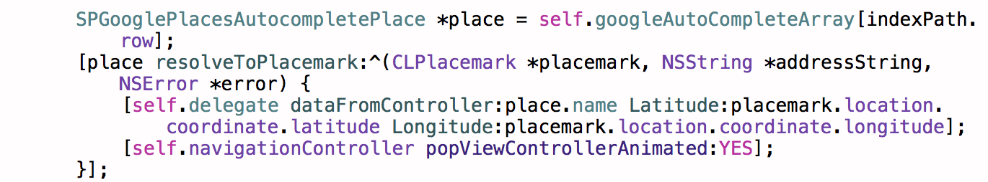
Using Location
When you click on a row, this happens:
What this means: Using the Google Places Autocomplete API, when you click on the row,
we use a delegate a protocol method to send specific data back to the initial View Controller.
The data is passed back through a method called dataFromController, whose parameters are the
name of the address, its latitude, and its longitude.

Slide 9
Technologies
Google Places Nearby Search API
Google Places Autocomplete API
Yelp API
FourSquare API

Slide 10
Next Steps
Create a more accurate way to compare across the three data sources
i.e. finding the delta between differentiating latitude and longitude
Understand Yelp’s OAuth Procedure
Please, no more custom Oauths...
Add features to the venue details, such as the ability to call, and for lack of a better word, pinpoint on a map

Slide 11

¿ Any Questions?

Slide 12
Thank you
iOS 004 Presentation
Nicolas Rizk & Tom Prezioso
March 24, 2015

